Slide 1

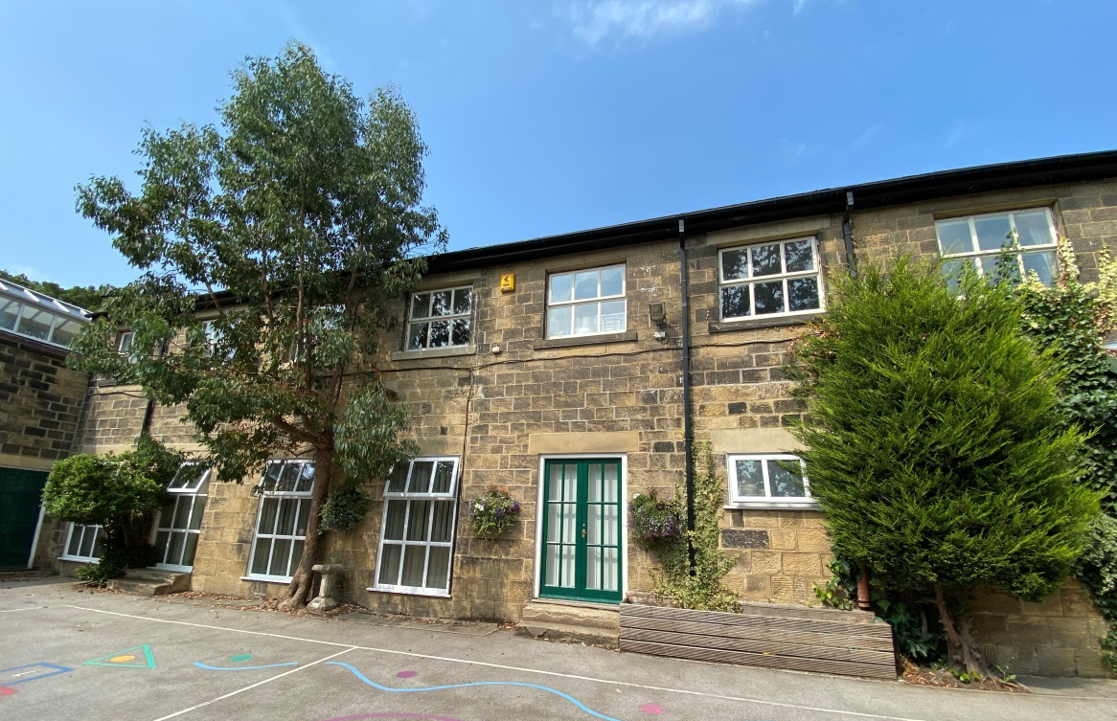
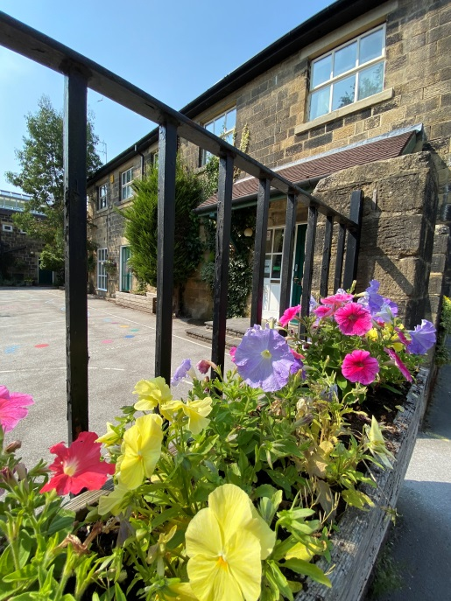






@LadyLanePark

Slide 2


@LadyLanePark

Slide 3
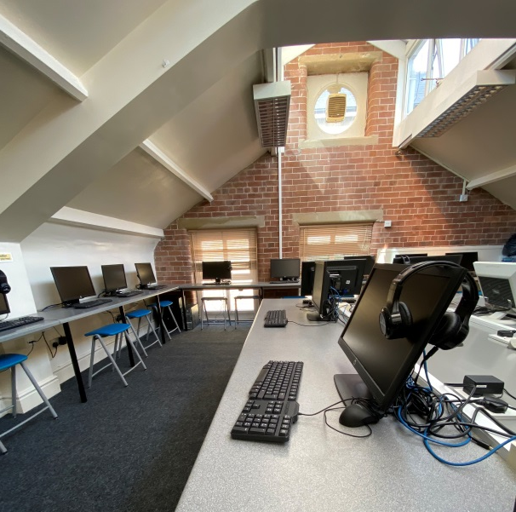
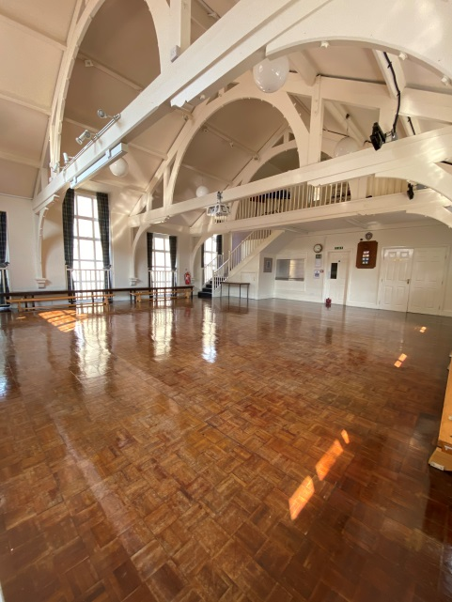
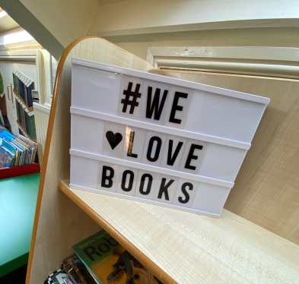
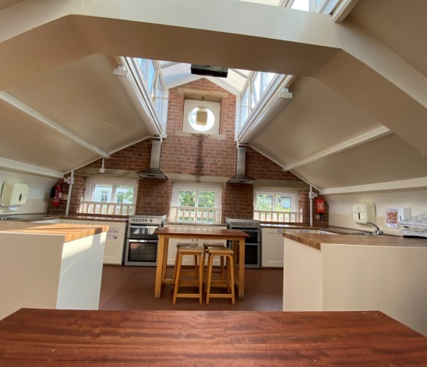
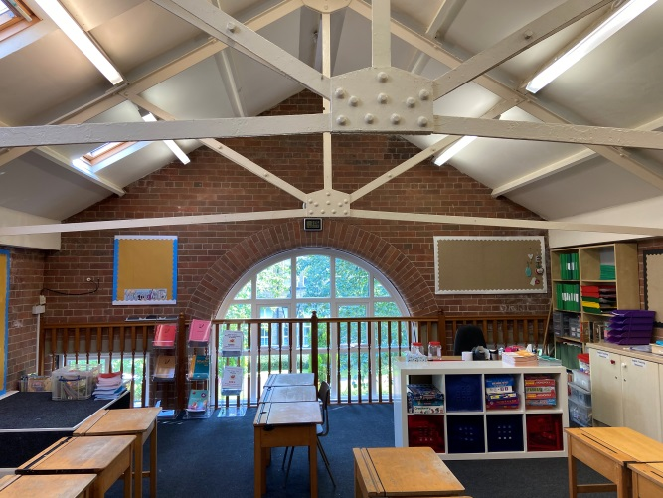
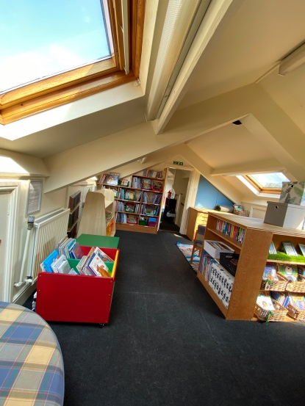
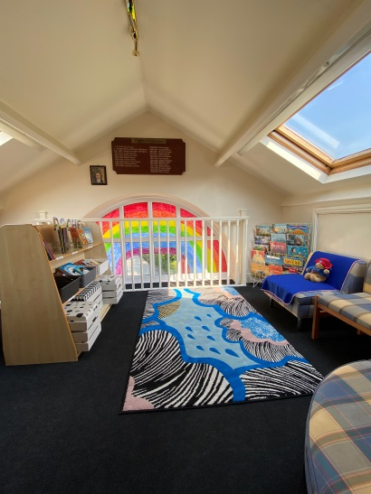
Our School
Library
Computer Suite
Science Laboratory
Music Room
Baking & Cooking lessons
Spacious Classrooms
Beautiful Grounds

Slide 4
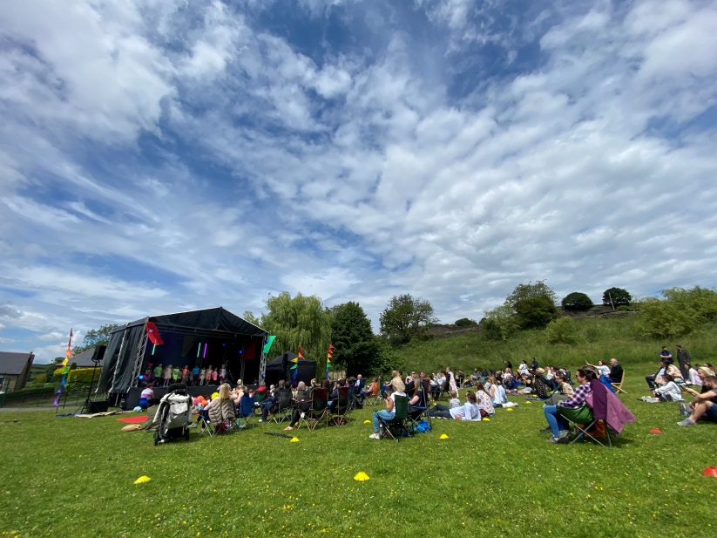
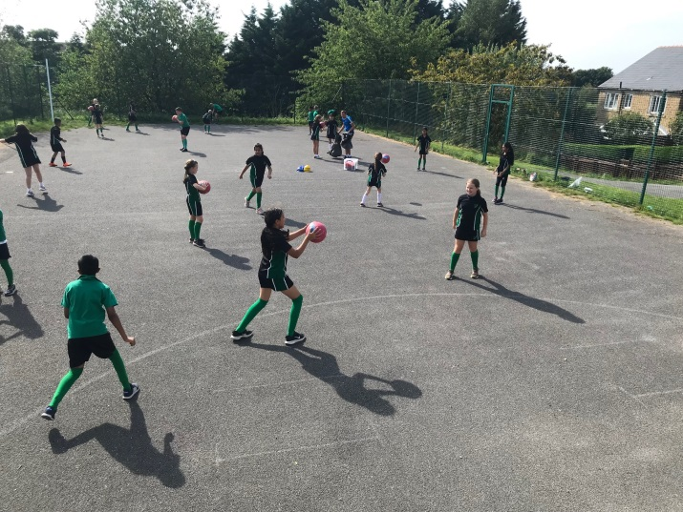

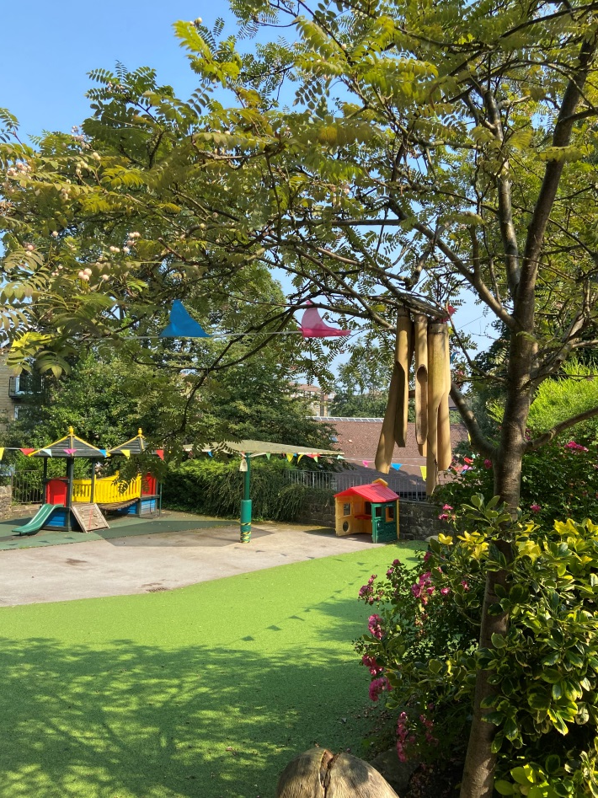
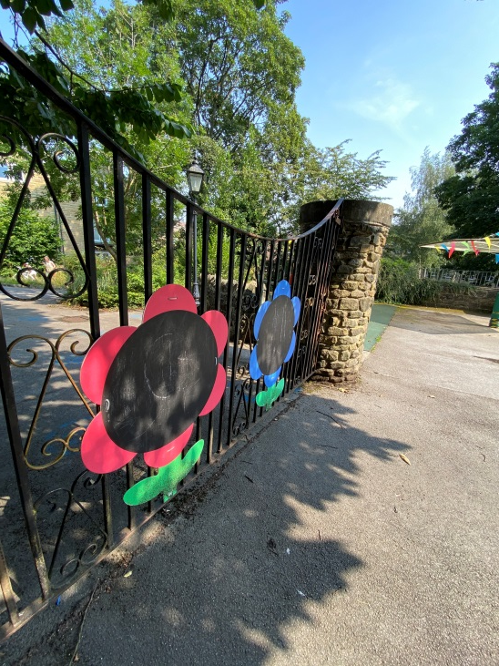
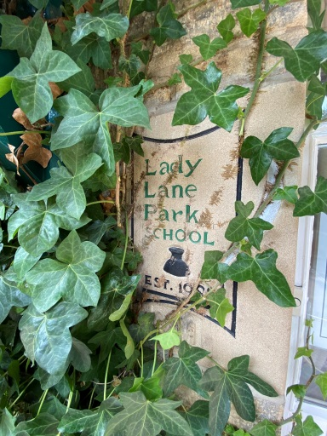
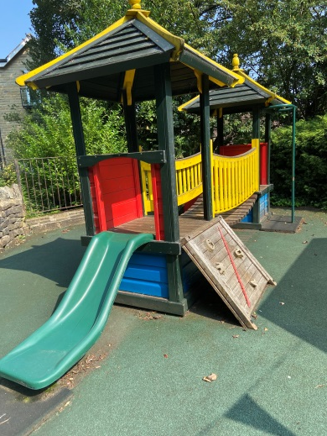
Outdoor Space

Slide 5
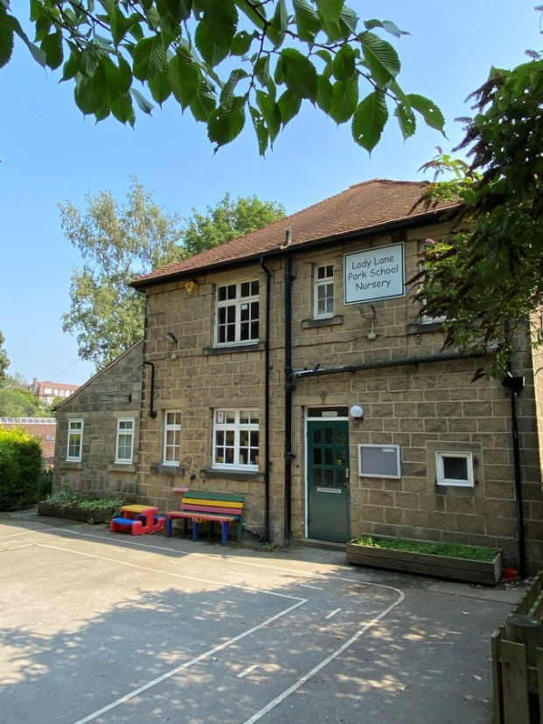
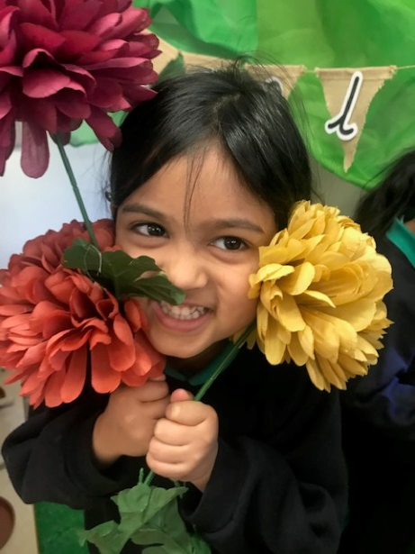
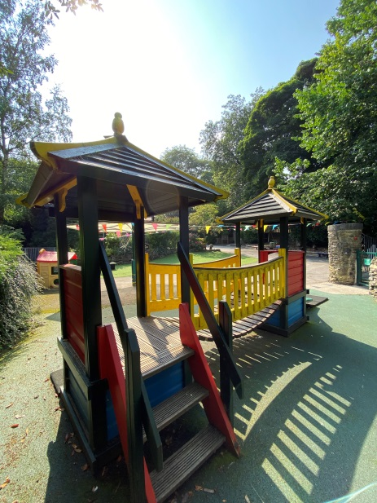
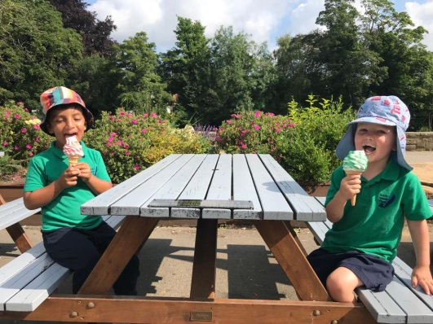
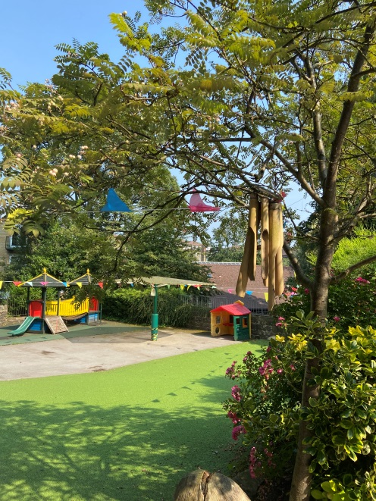
Lady Lane Park Nursery
Beautiful Grounds for our Nursery
Pupils from age 2
15 hours funding available
Open 50 weeks; 7.30am-6.00pm
Highly experienced practitioners supported by our fantastic Nursery Manager
Development Matters Curriculum
Tapestry Assessment Tool
Class Dojo

Slide 6







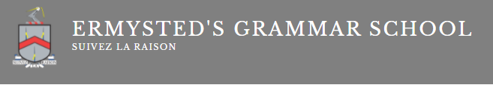
Exam Success & Scholarships

Slide 7

Exceptional results for our
Year 6 pupils in 2020-2021 Cohort

Slide 8
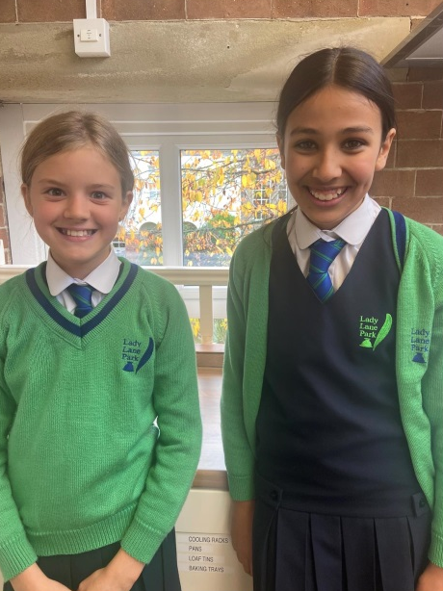
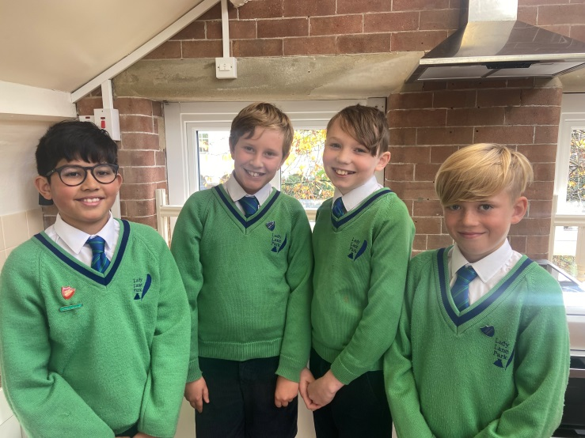
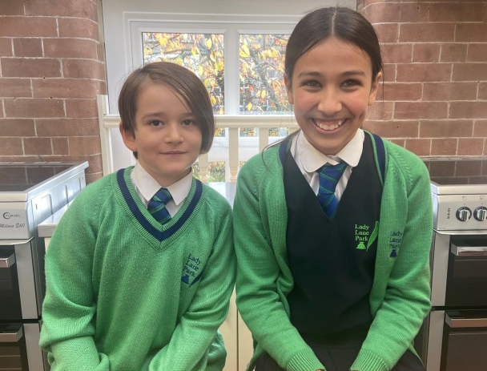
Results so far for 2021-2022

Slide 9
Support for Exam Preparation
All pupils begin formal Non-verbal & Verbal reasoning lessons & homework in Year 3
A varied and stretching curriculum throughout school ensures that all pupils are confident, resilient and enjoy learning
In Year 5, additional 11+ study groups for pupils sitting entrance exams in Year 6 before school
Additional study groups are taught by our English & Maths Specialist staff, who also teach in Year 5 & 6.
Accelerated learning support to stretch high achieving pupils
Interview rehearsals for all Year 6 pupils with a visiting Head Teacher from the group.
A balanced curriculum continues to ensure that the well-being of all pupils is considered
Pastoral support for pupils facing a challenging time in their lives
Support to parents, who also find this time challenging

Slide 10
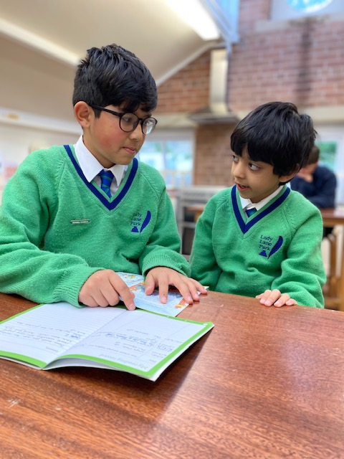
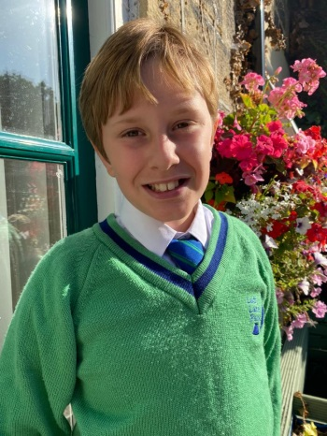
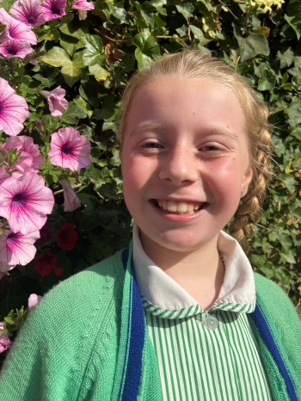
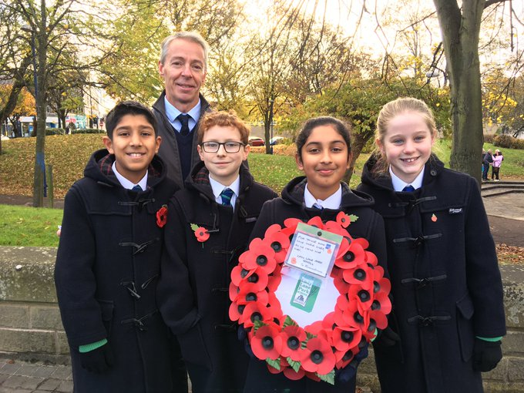
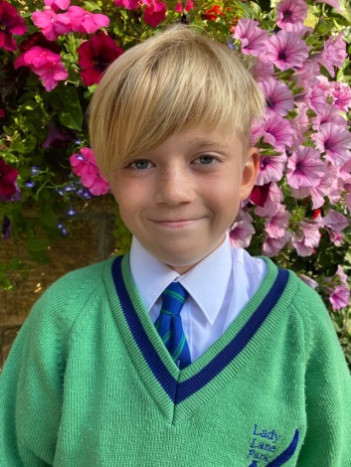
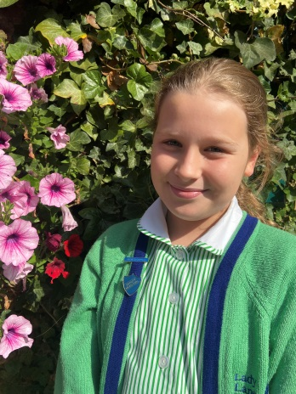
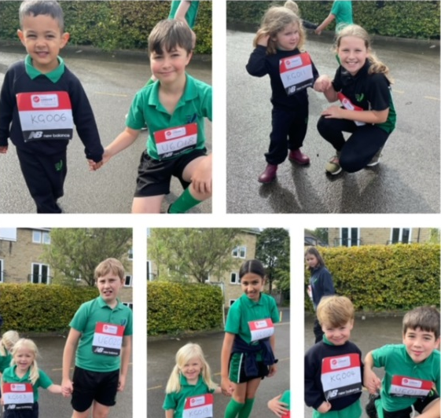
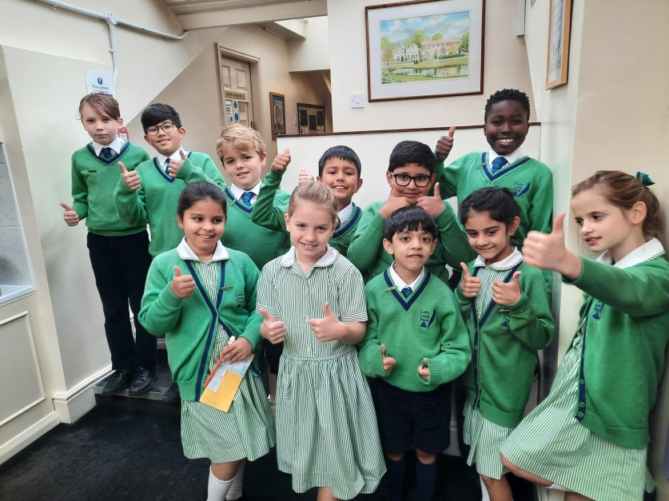
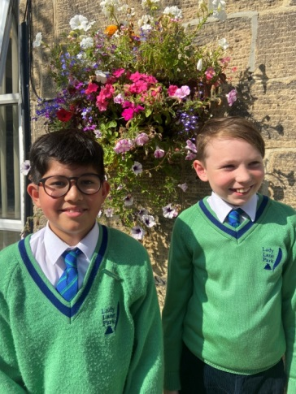
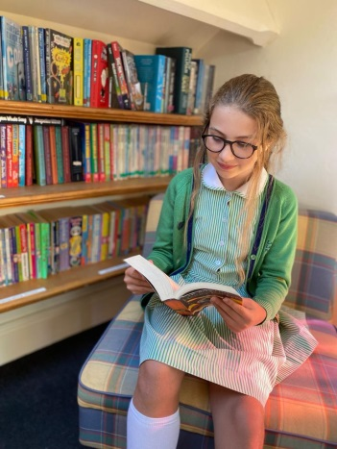
Leadership

Slide 11
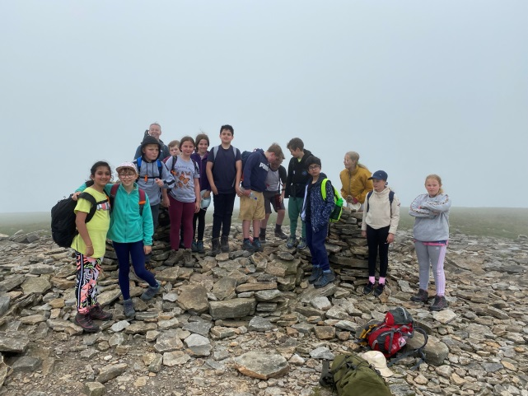
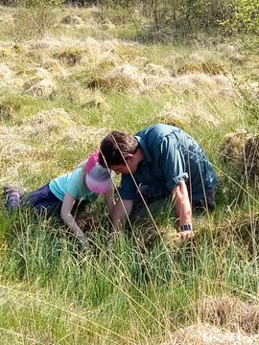
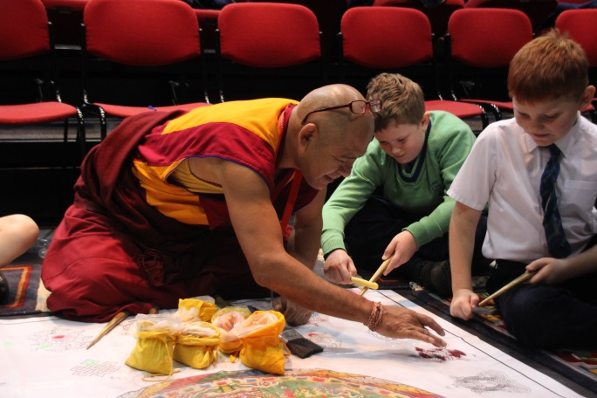
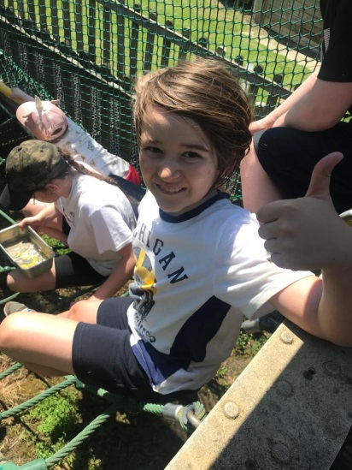
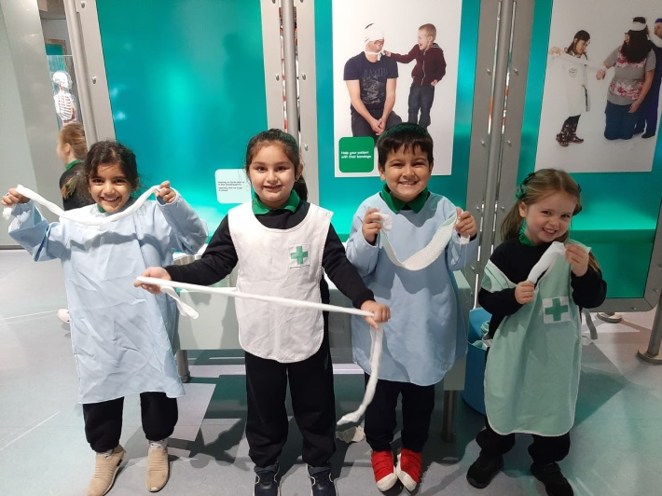
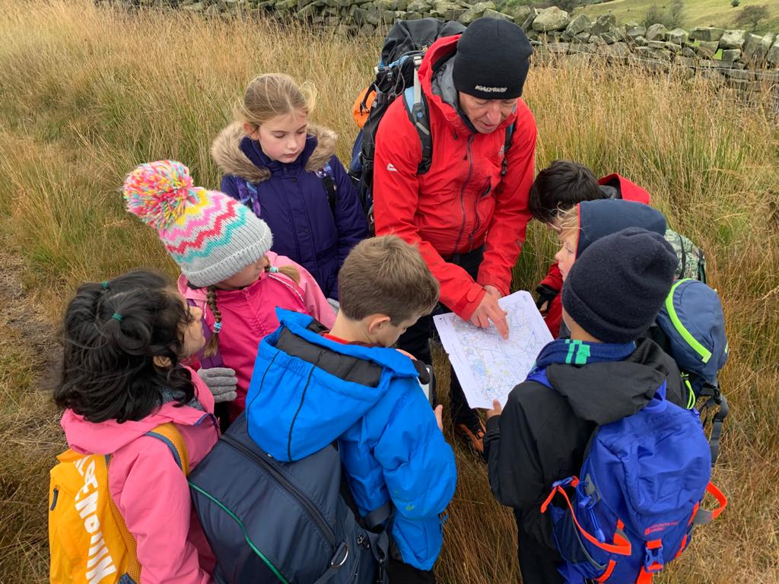
Enrichment
Year 5 & 6 Residential in the Summer Term (5 days)
Year 3 & 4 Residential in May (4 days)
Year 6 complete the 3 Peaks Challenge
At least one trip per term for every pupil

Slide 12
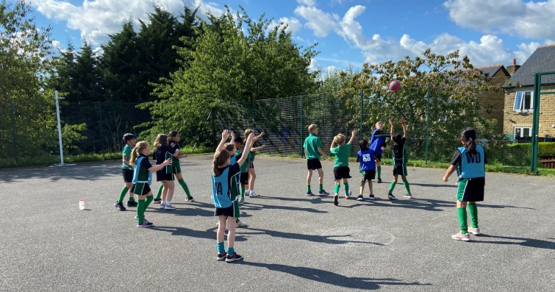
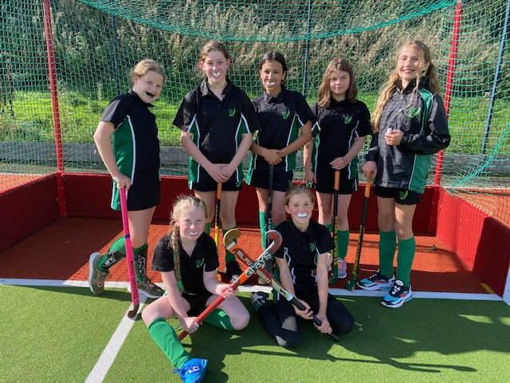
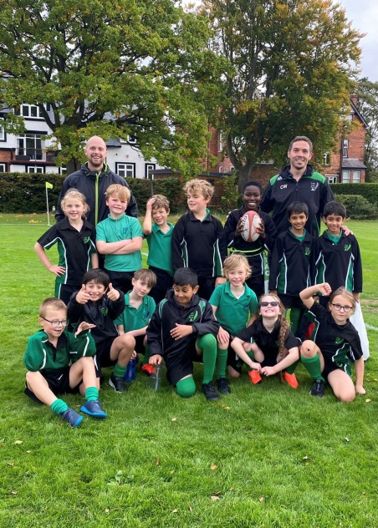
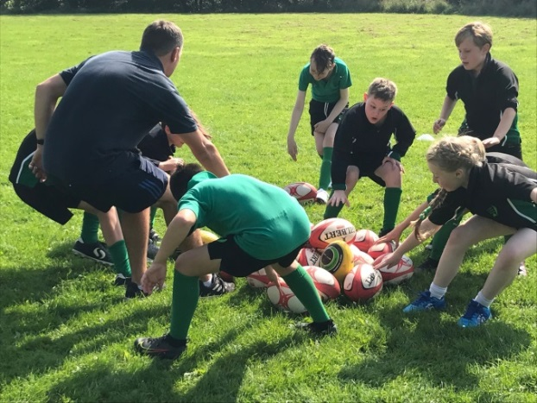
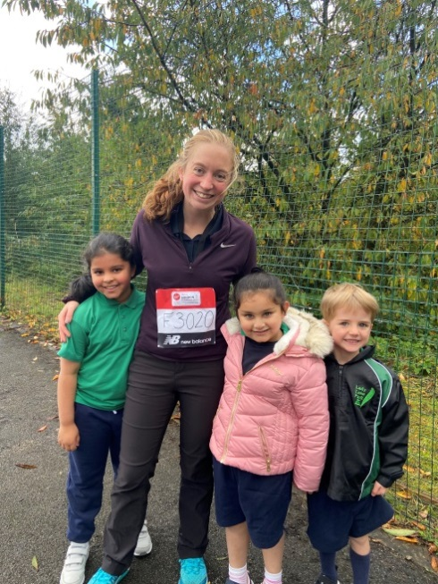
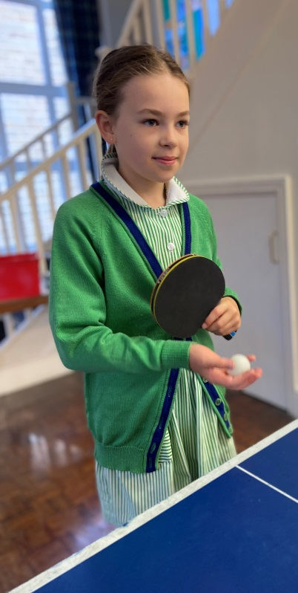
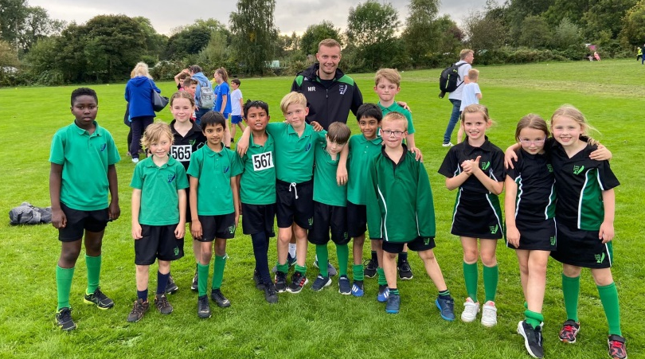
Sport Coaching & Fixtures
Specialist Sports Coaching for all pupils from Reception to Year 6
Regular fixtures home and away

Slide 13

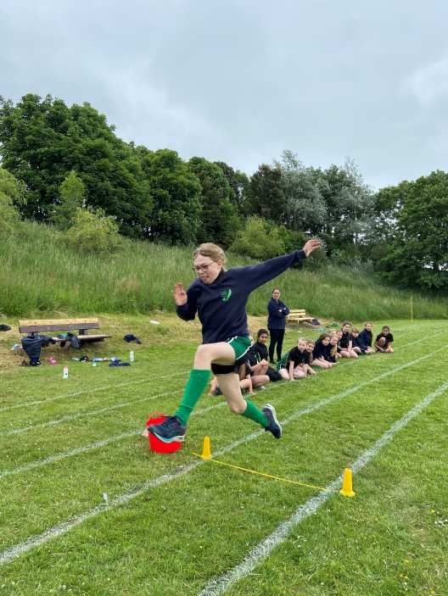
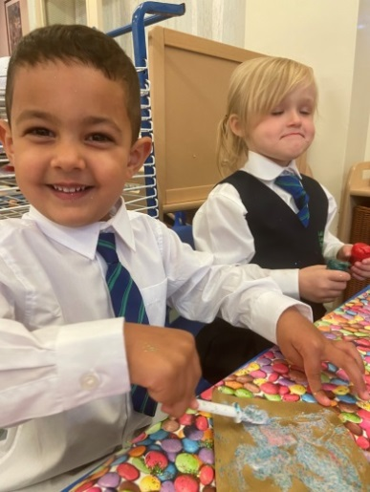
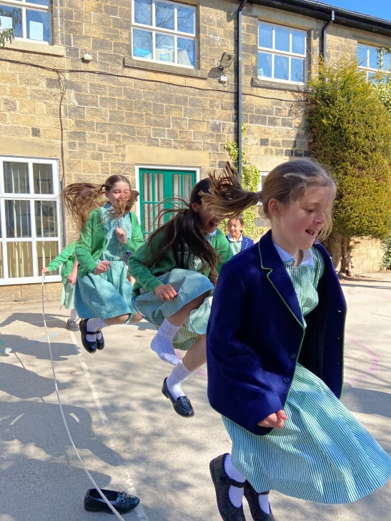





Extra-Curricular Clubs

Slide 14







Music & Drama
Specialists Music & Drama Teachers
Weekly Music & Drama lessons for all pupils from Year 2
Pupils from Nursery to Year 6 take part in our Summer Celebrations
Lady Lane Choir who perform at Young Voices

Slide 15











Charity support & links within the community

Slide 16
Wrap-around Provision (Crèche)
In addition to our many, free of charge, extra-curricular clubs we also offer wrap-around provision in our Crèche facility for all our pupils. Our Crèche supervisors are highly experienced and a continual friendly face for our pupils.
7.30am – 8.40am (including breakfast)
3.30pm – 6.00pm (including light snack)
Pricing - £3.50 per half-hour

Slide 17
Catering Team
School Cook prepares freshly cooked meals for all pupils, supported by our skilled catering team.
All dietary requirements are catered for on an individual basis.
Healthy balanced meals, with both vegetarian and Halal options available.
5 Star Hygiene Rating.
Weekly menus are published in advance in our School Bulletin.
Theme days to fit with special events.
Pupil choice days throughout the year

Slide 18
Home-School Partnership
Class Dojo School Community Platform
Weekly Blogs on Class Dojo every Friday for each form
Half-term curriculum newsletters from Form Teachers in advance of a new term
Homework communication through Class Dojo
Parents have direct contact with Form teachers on Class Dojo between 8.00am – 4.00pm, Monday – Friday
Whole school weekly newsletter – ‘The Bulletin’
Termly Parent’s Consultations for all pupils, including Nursery
Annual end of year report in the Summer term, for all pupils, including Nursery

Slide 19
Housekeeping
Full time House Keeping team, responsible for continual cleaning of all communal areas in school
Hand-washing routines remain in place
All school areas are well ventilated and COVID secure though out the day
Secure entry system

